Slide 1






DBS Banking Analytics

Slide 2


Group details
Group 4
Mercy
Ranjith Kumar R
Rohit Chaubelal Sahu
Chaitra Turmari
Soundarya G S
Susmita Das

Slide 3



Summary
We have built dashboards in Excel, Tableau, and Power BI to track the full journey of banking operations, client activity, loans, and transactions.
It shows all key KPIs in one place, making it easy to monitor loan performance, client retention, repayment behavior, and transaction trends, along with high-risk activities and branch performance.
Objectives
Combine banking, loan, repayment, and transaction data into one clear view.
Identify high-performing branches, profitable products, and top clients.
Enable banks to make faster, data-backed decisions on lending, collections, and branch operations.
Provide accessible insights across Excel, Tableau, and Power BI for different teams.
Impact
Better decision-making by identifying risk areas and growth opportunities.
Faster action on delinquent loans or suspicious transactions.
Easy access to KPIs for all teams, in their preferred BI tool.
More accurate financial and operational forecasting.

Slide 4
KPIs
Banking Dashboard
Debit & Credit Dashboard
Total Clients / Active Clients / New Clients
Client Retention Rate
Total Loan Amount Disbursed & Average Loan Size
Principal Recovery Rate & Interest Income
Default Rate, Delinquency Rate, On-Time Repayment %
Loan Distribution by Branch & Branch Performance
Product-wise Loan Volume & Profitability
Total Credit Amount & Total Debit Amount
Credit-to-Debit Ratio
Net Transaction Amount
Account Activity Ratio
Transactions per Day/Week/Month
Total Transaction Amount by Branch / Bank
Transaction Method Distribution
Branch Transaction Growth %
High-Risk Transaction Flag & Suspicious Transaction Frequency

Slide 5
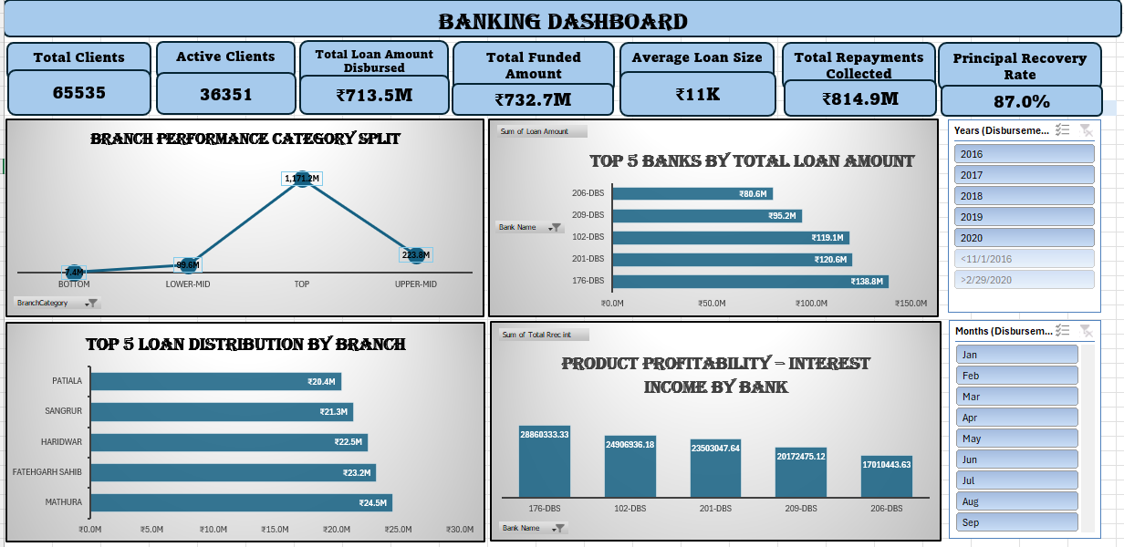
Excel Dashboard (1/2)

Slide 6
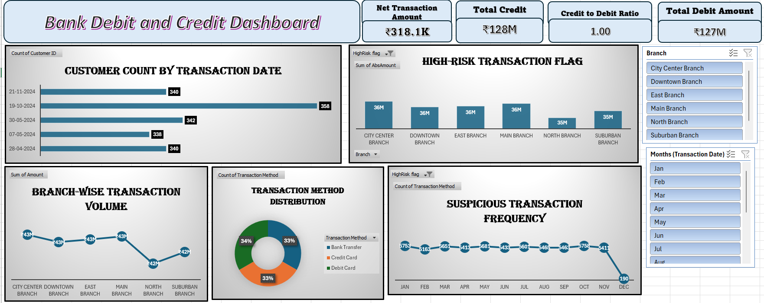
Excel Dashboard (2/2)

Slide 7
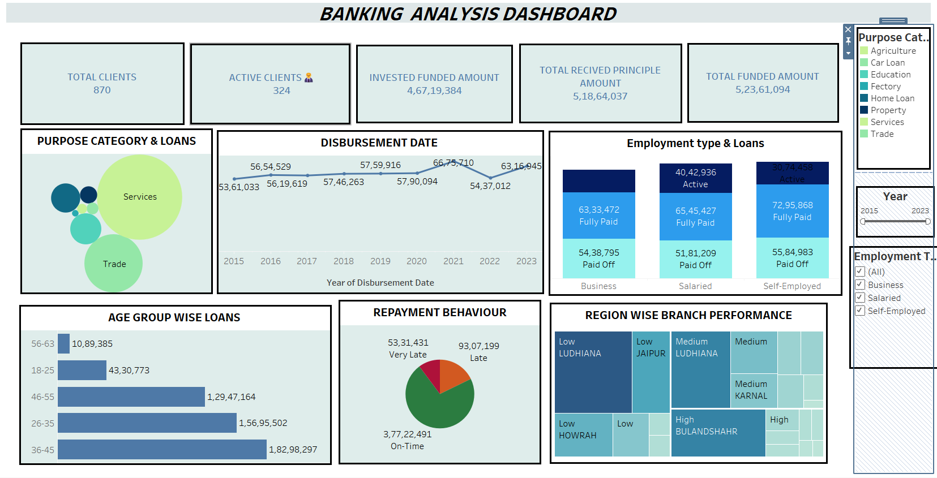
Tableau Dashboard (1/2)

Slide 8
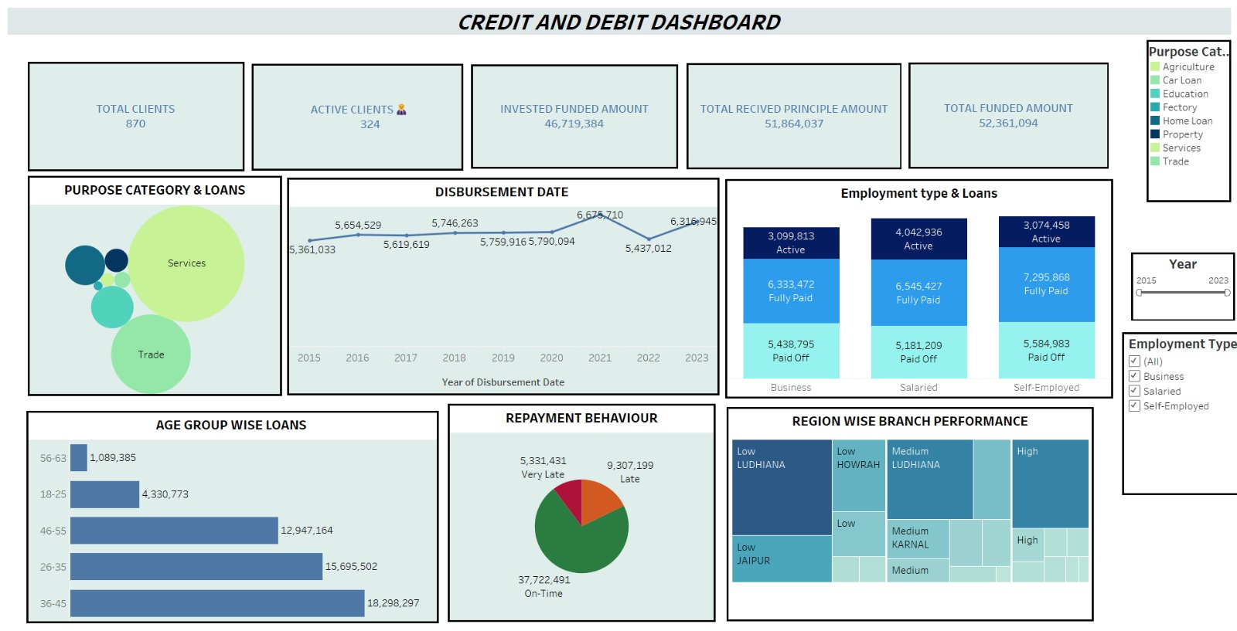
Tableau Dashboard (2/2)

Slide 9
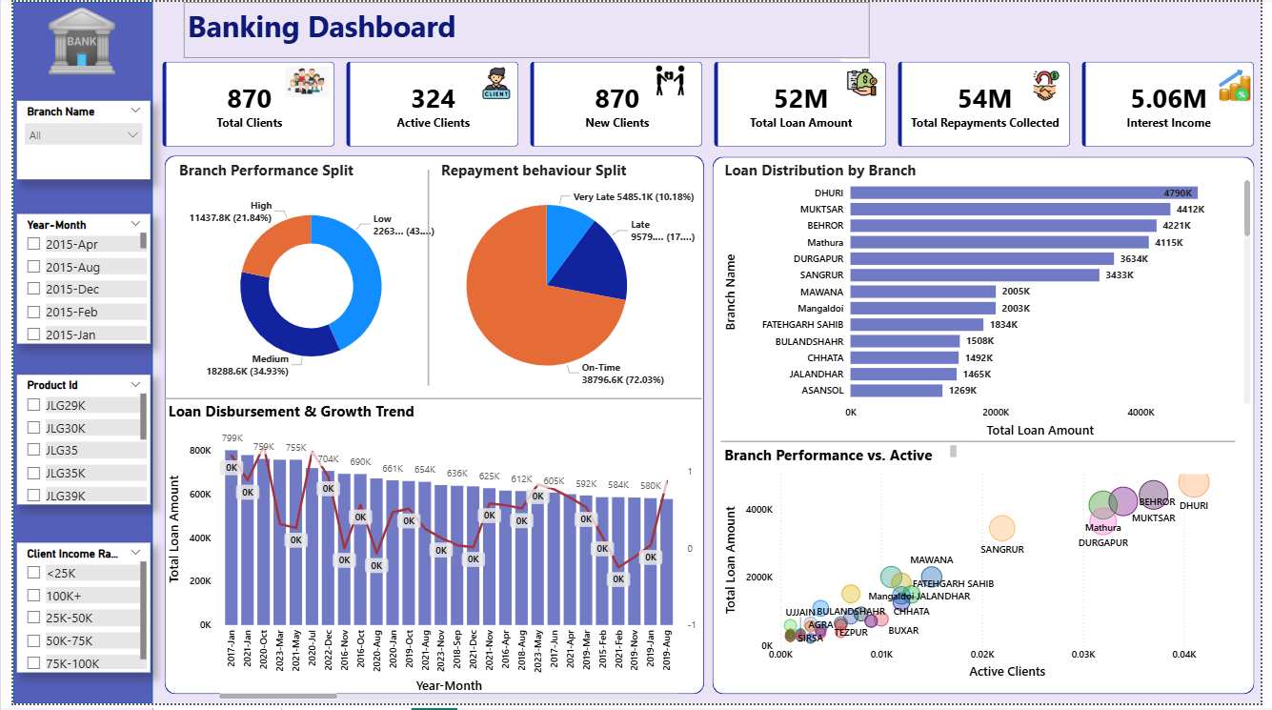
Power BI Dashboard (1/2)

Slide 10
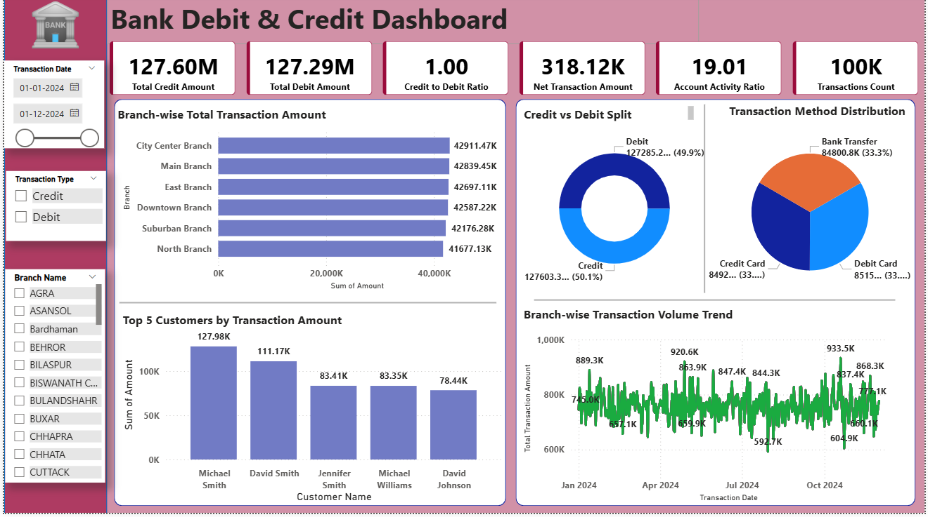
Power BI Dashboard (2/2)

Slide 11
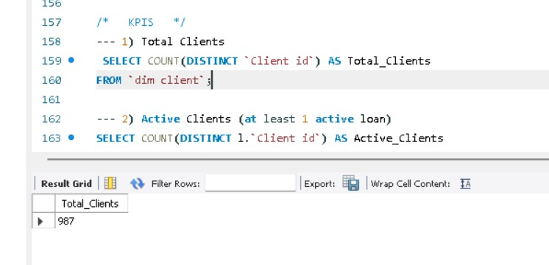
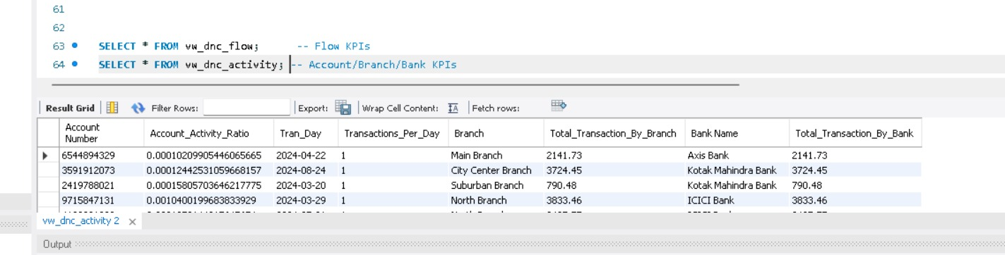
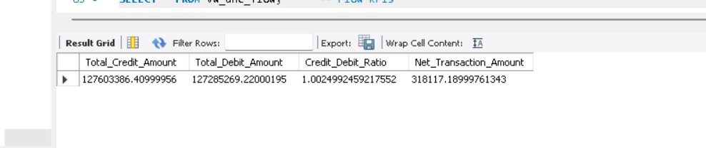
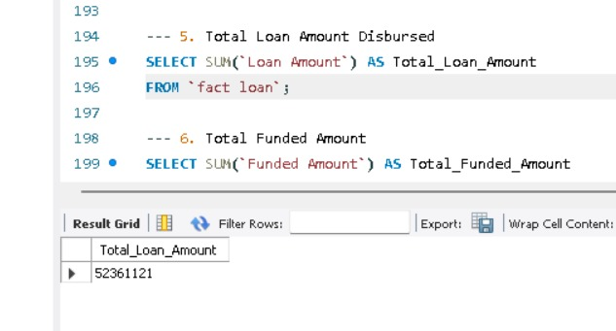
SQL Query

Slide 12
Takeaways - KPIs
for Banking Dashboard
for Debit & Credit Dashboard
Total Clients- 65K+ overall.
Active Clients- 36K+; steady growth in new clients.
Loan Disbursed- ₹713.5M total.
Recovery- 87% principal recovery, 72% on-time repayments.
Top Branches- 176-DBS, Dhuri, and Mathura lead in performance.
Total Credit- ₹128M | Total Debit: ₹127M.
Net Flow- Positive balance of ₹318K.
High-Risk Transactions- ₹36M per branch flagged.
Suspicious Activity- 5K cases monthly.
Transaction Methods: Evenly split across Credit, Debit, and Bank Transfer.

Slide 13
Takeaways- Business Insights
Client growth is steady, but retention strategies needed.
Loan defaults & delays still pose a financial risk despite good recovery rates.
Certain branches consistently outperform others → potential to replicate best practices.
Balanced debit-credit ratio reflects healthy banking operations.
High-risk & suspicious transactions need stronger fraud monitoring.

Slide 14
Takeaways- Challenges
Repayment & Default Risks
High-Risk & Suspicious Transactions
Complex Data Preparation
Uneven Branch & Client Performance
Large volumes of flagged transactions highlight a challenge in fraud detection and monitoring..
Merging Excel datasets into SQL and building relationships was complex.
Certain branches and client groups dominate while others lag — creating a challenge in ensuring balanced growth and fair benchmarking.
Although recovery is strong (87%), late repayments and default cases reduce profitability and increase financial risk.

Slide 15
Thank You!

